Slide 1

CAPSTONE PROJECT-3
Fraud prediction
Logistic regression
Random Forest Classification
XGBoost Classification
Artificial neural networks

Slide 2
Group Members
DA2101 - Oğuzhan
DA2102 - Birgül
DA2103 - Pakize

Slide 3
Main StepS
Data Cleaning & EDA
1
Data Preprocessing
2
Model Building
3
Evaluating and Comparing the Models
4
Model Deployment
5

Slide 4
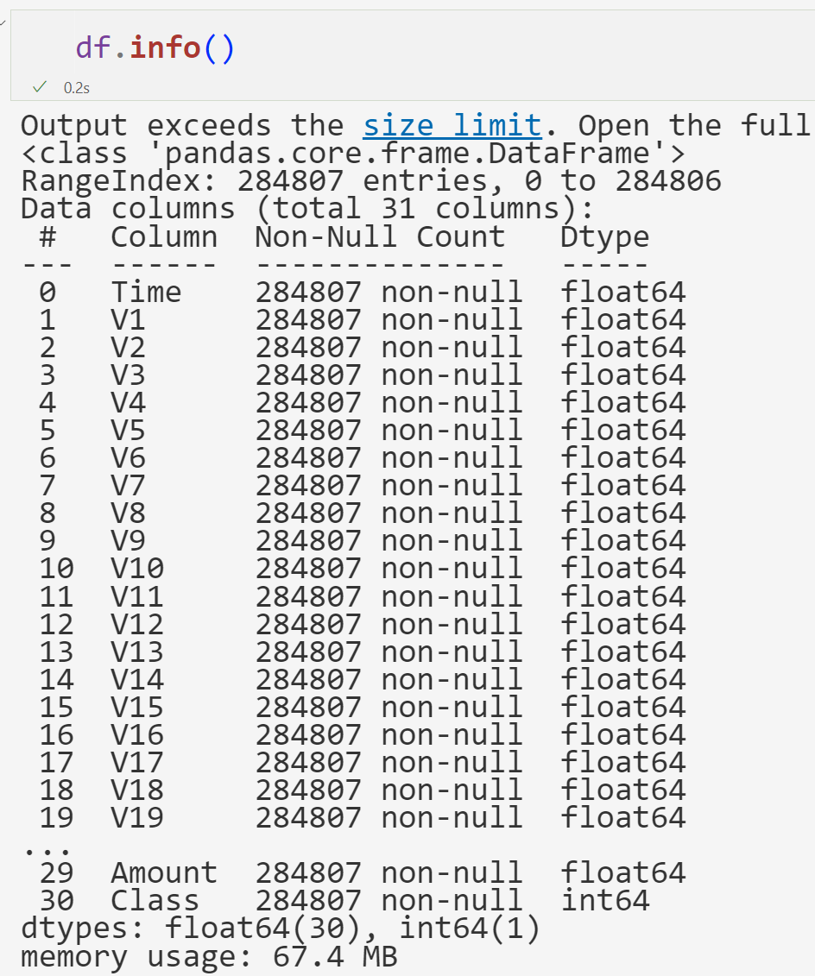
Creditcard dataset
Columns: 31 Rows: 284807
Duplicated: 1081
Missing Values: 0

Slide 5
dataset
Feature Information:
Time: This feature contains the seconds elapsed between each transaction and the first transaction in the dataset.
Amount: This feature is the transaction Amount.
Class: This feature is the target variable and it takes value 1 in case of fraud and 0 otherwise.
Features V1, V2, … V28 contain only numerical input variables which are the result of a PCA transformation.

Slide 6

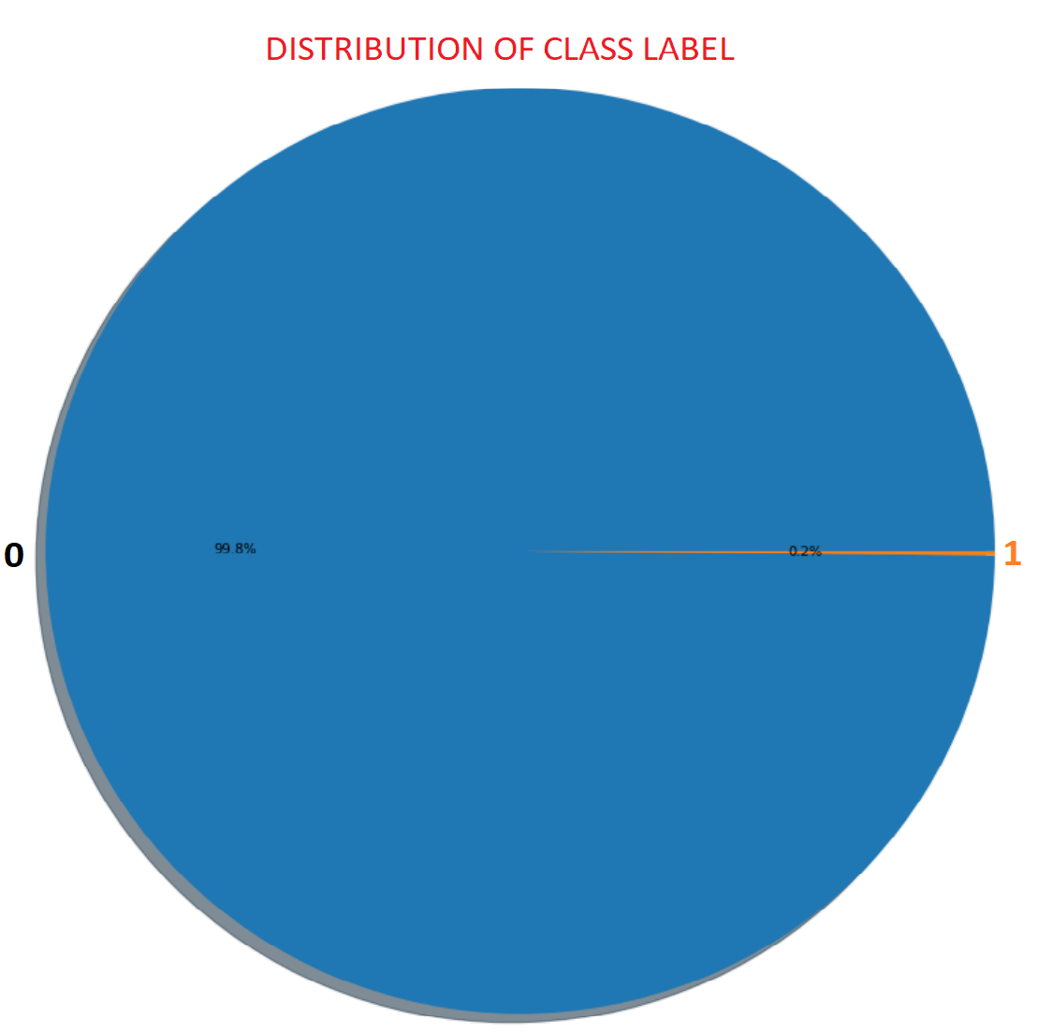
EDa
Percentage of Class-1: % 0.17
Percentage of Class-0: % 99.83
-----> Data is very unbalanced.

Slide 7
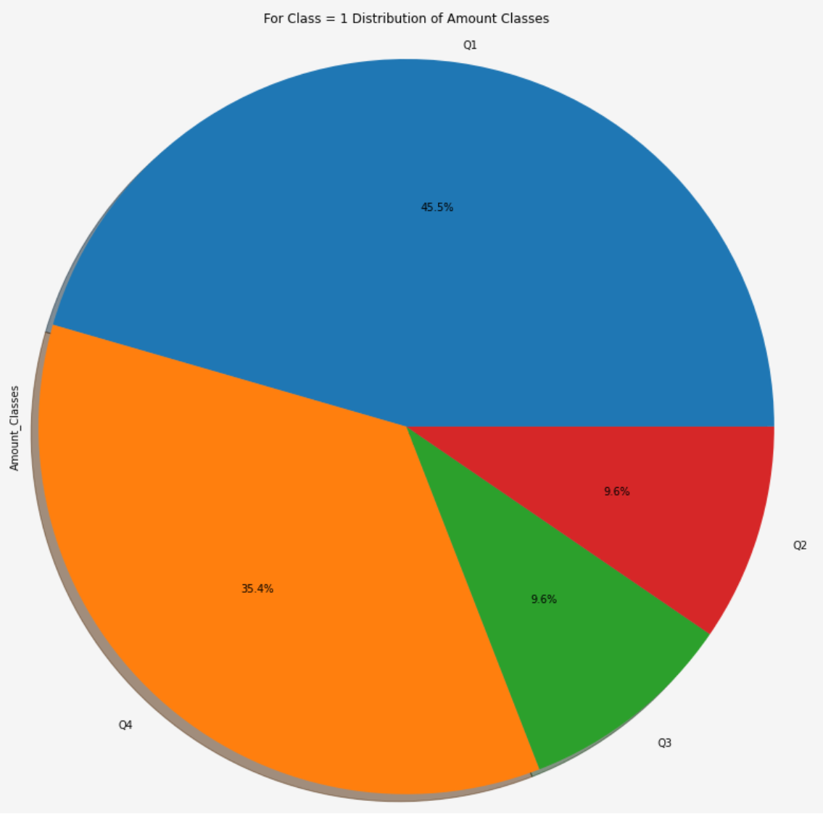
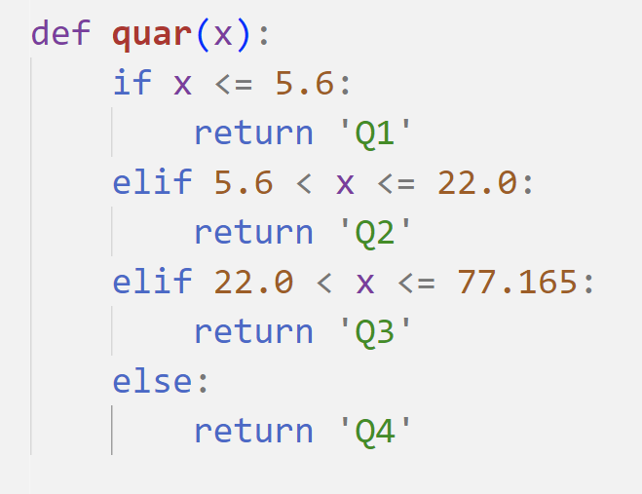
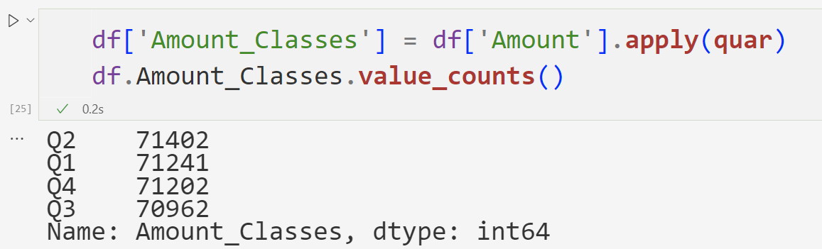
Number of fraudulent transactions for Q1 : 224
Total amount of fraudulent transactions for Q1: 261.32
Number of fraudulent transactions for Q2 : 47
Total amount of fraudulent transactions for Q2: 547.02
Number of fraudulent transactions for Q3 : 47
Total amount of fraudulent transactions for Q3: 2006.31
Number of fraudulent transactions for Q4 : 174
Total amount of fraudulent transactions for Q4: 57313.32

Slide 8
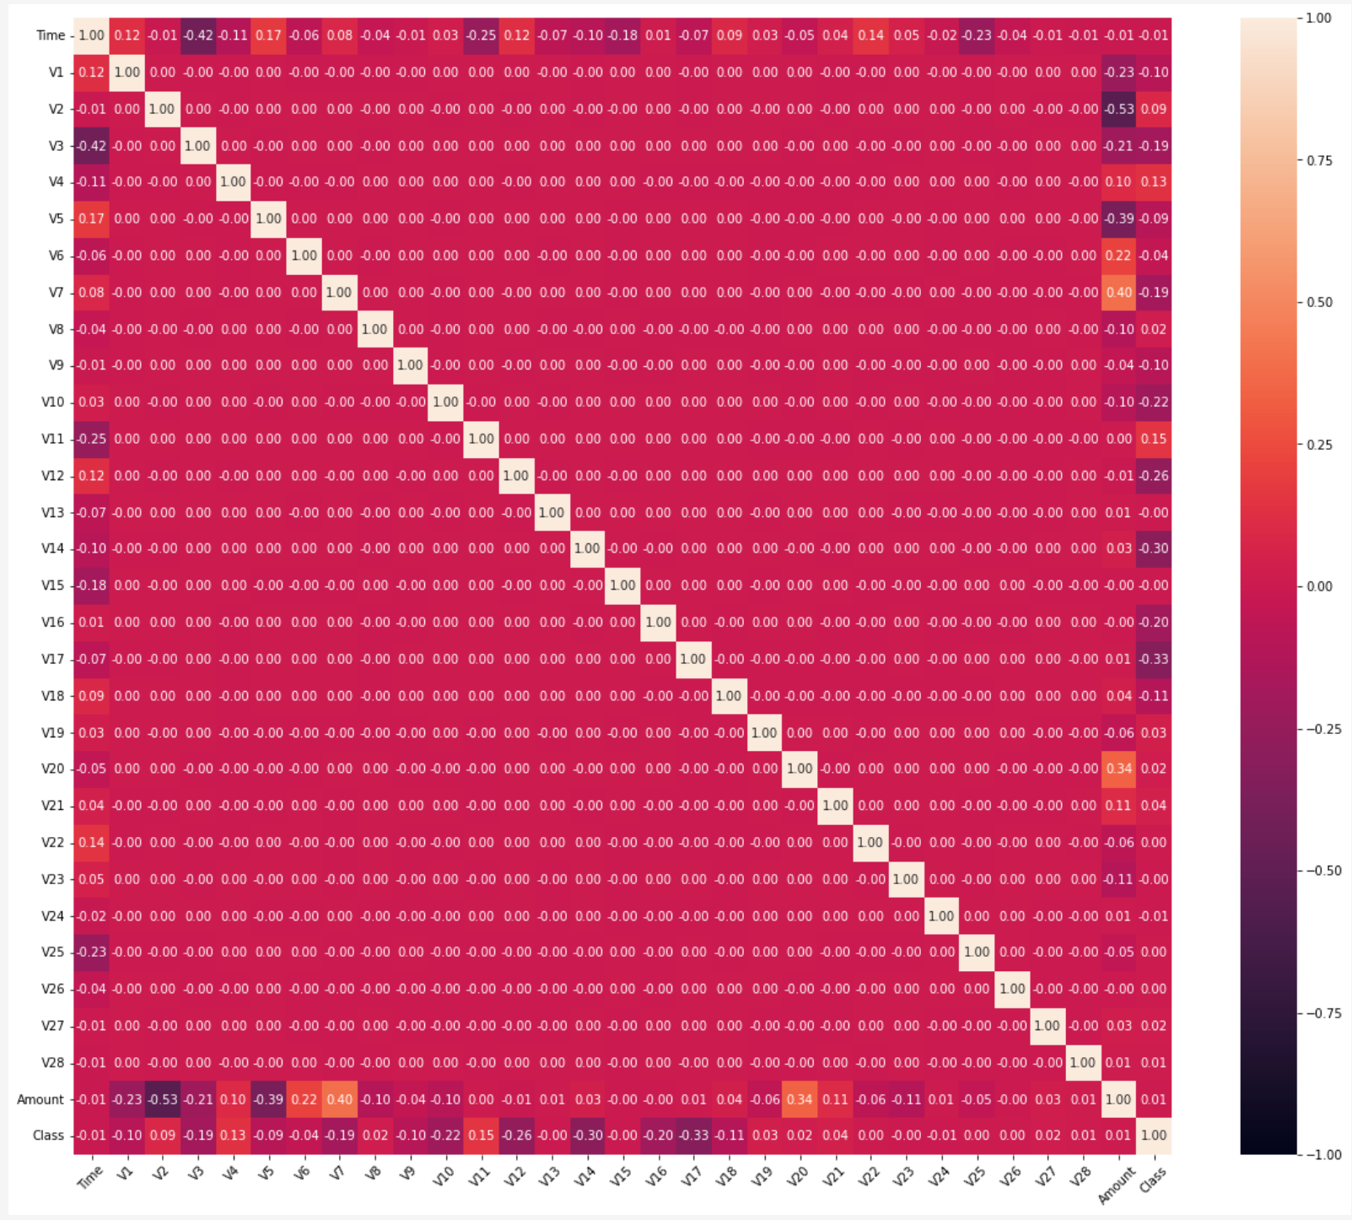
heatmap
There is no linear relationship between the columns. Columns starting with V were created with PCA.
Principal component analysis (PCA) is a technique that reduces the dimensionality of datasets, increases interpretability, but also minimizes information loss.
It does this by creating new 'unrelated' variables that successfully maximize variance.

Slide 9
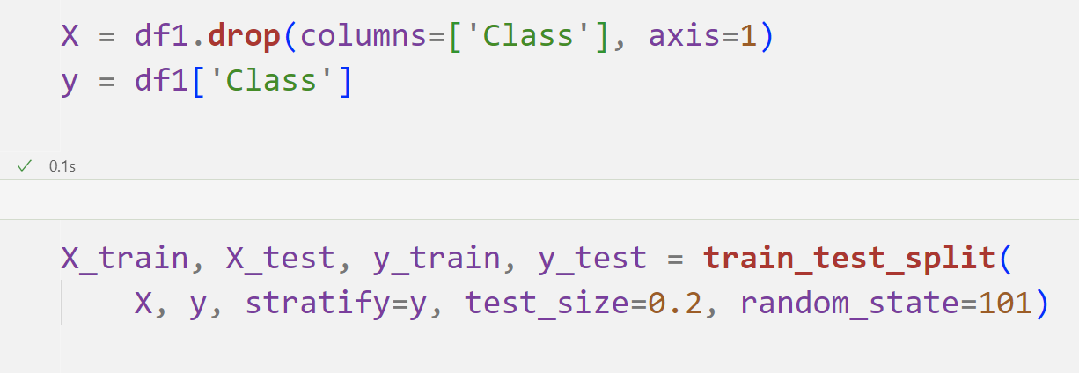
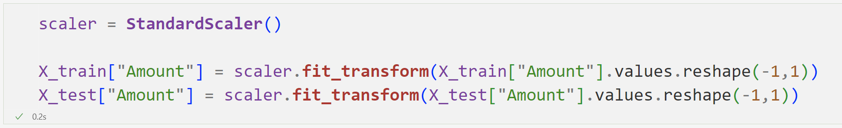
data preprocessing

Slide 10
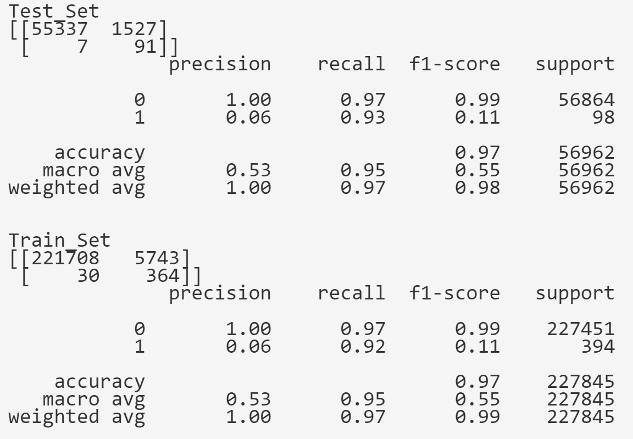
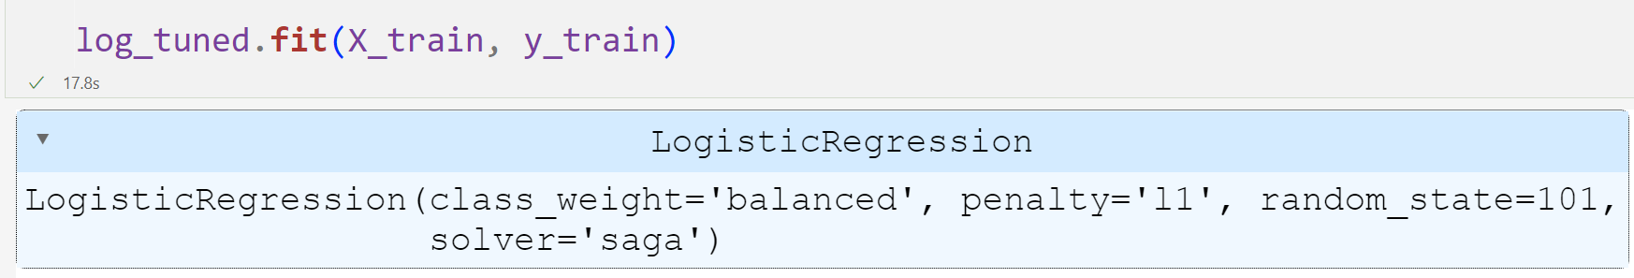
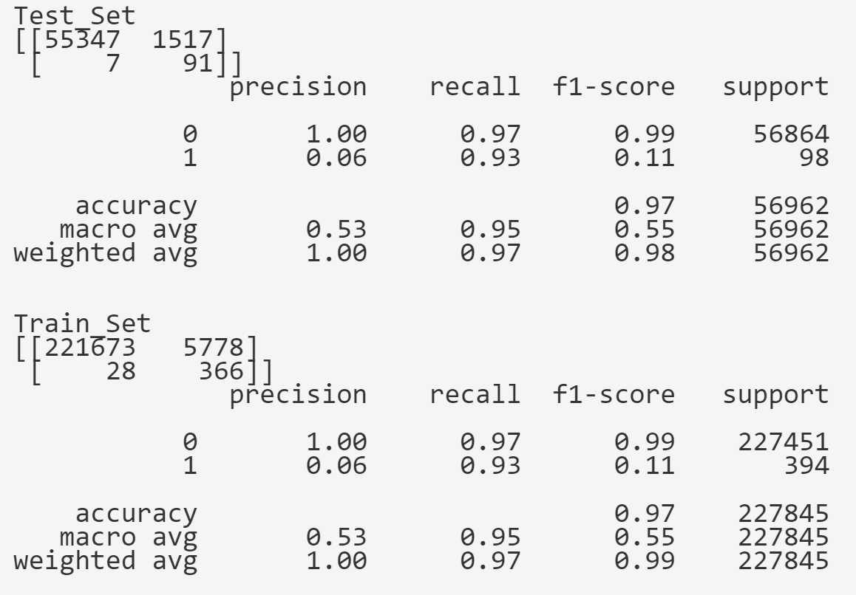
Logistic regression 1

Slide 11
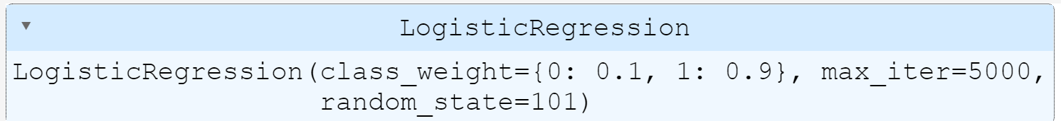
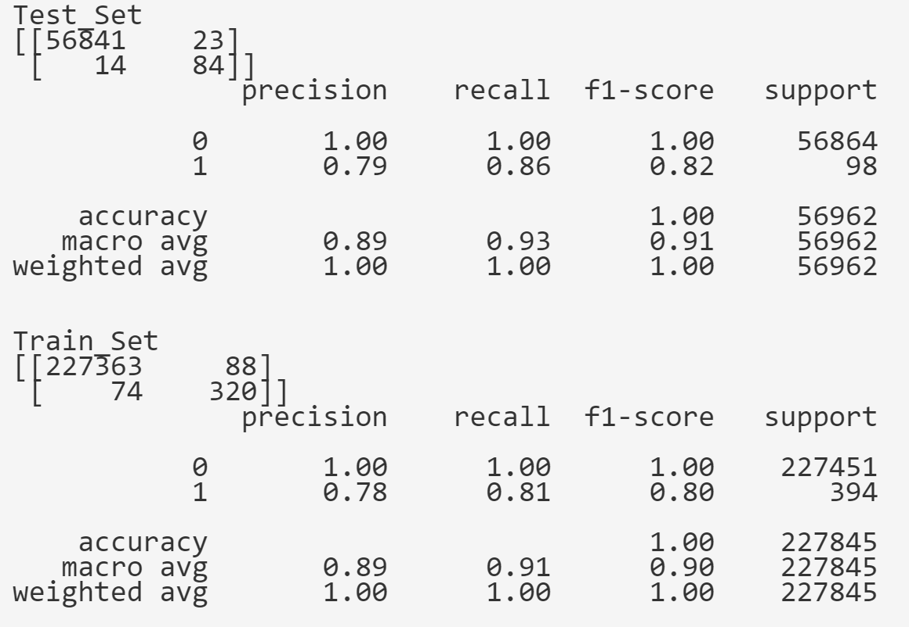
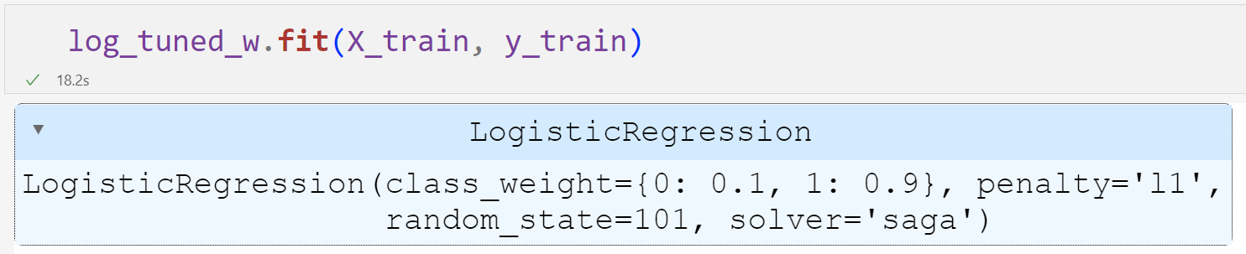
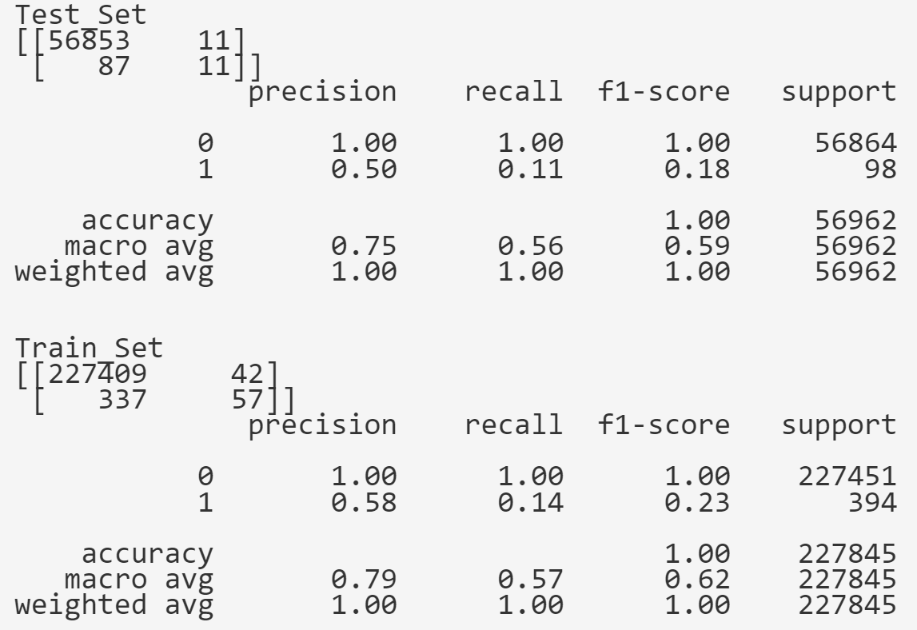
Logistic regression 2

Slide 12
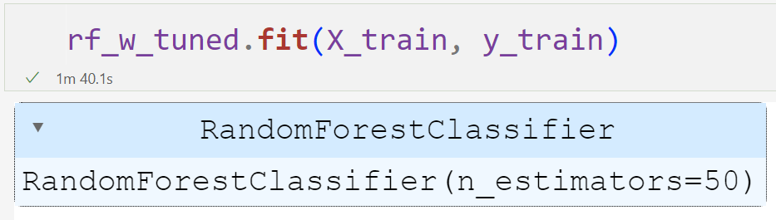
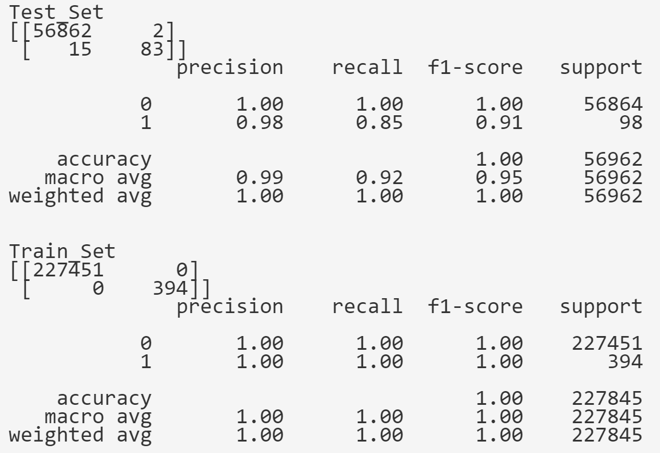
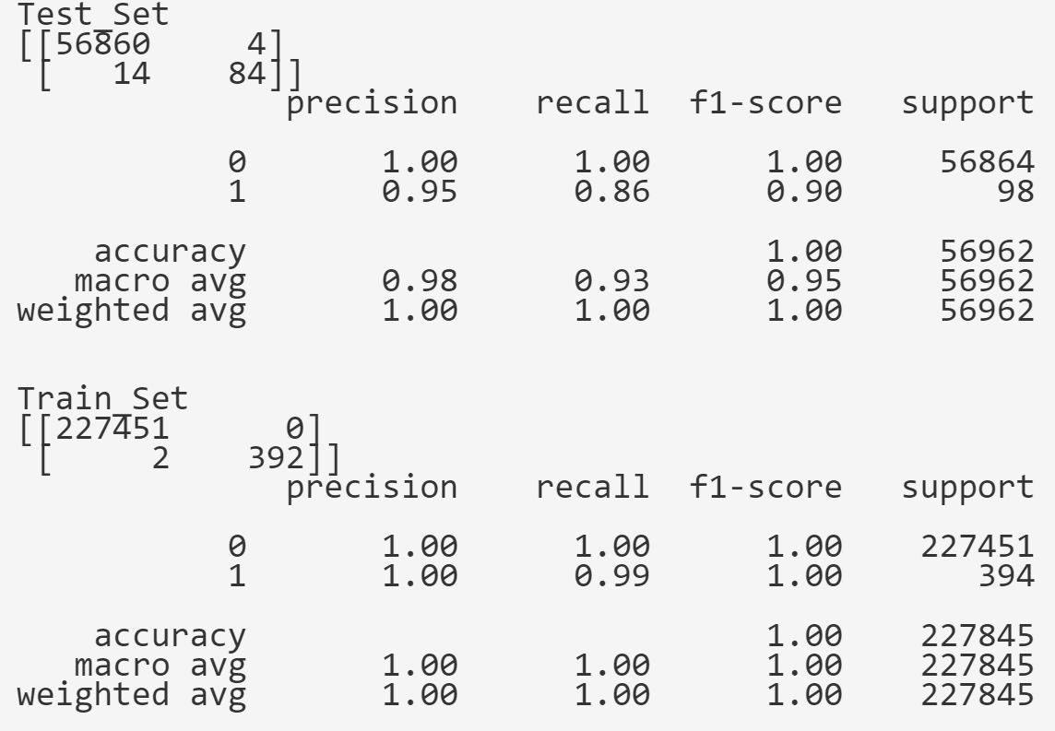
Random forest classifier

Slide 13
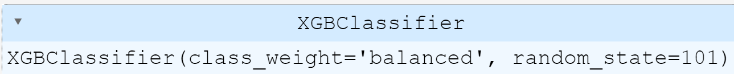
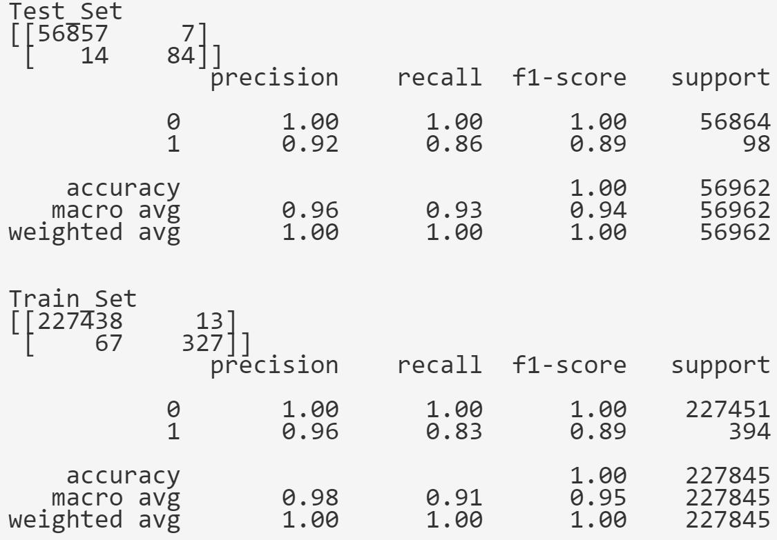
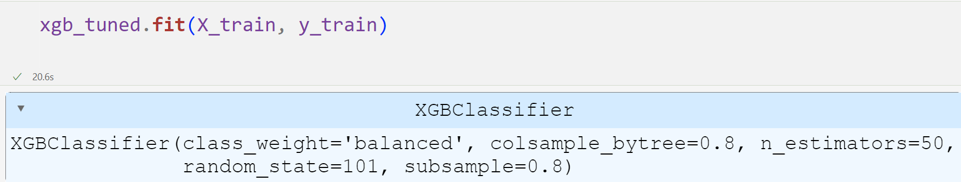
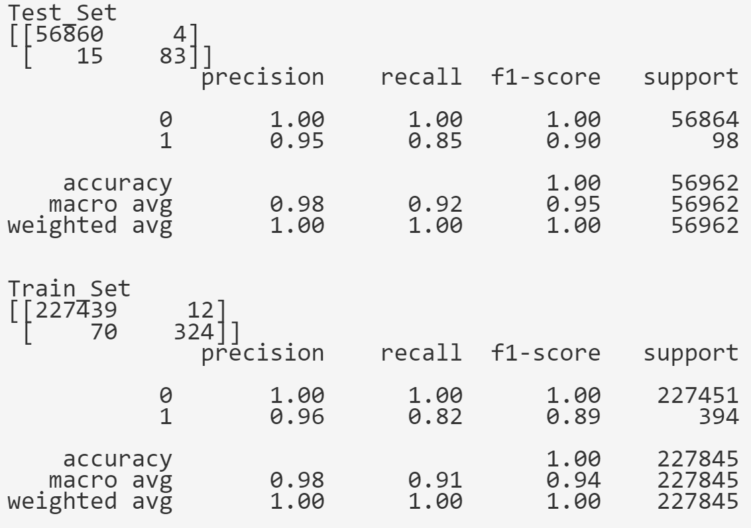

XGBoost Classifier

Slide 14
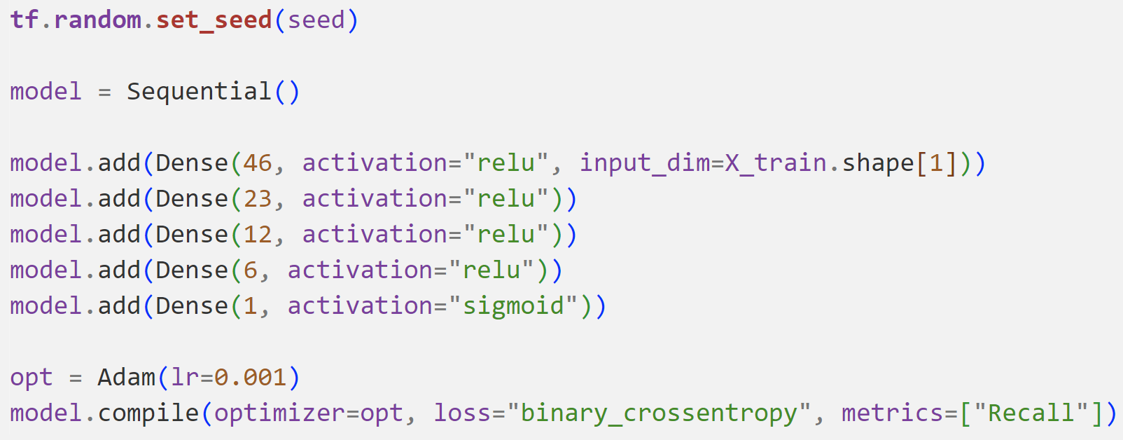
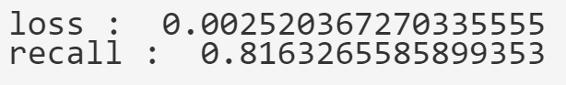
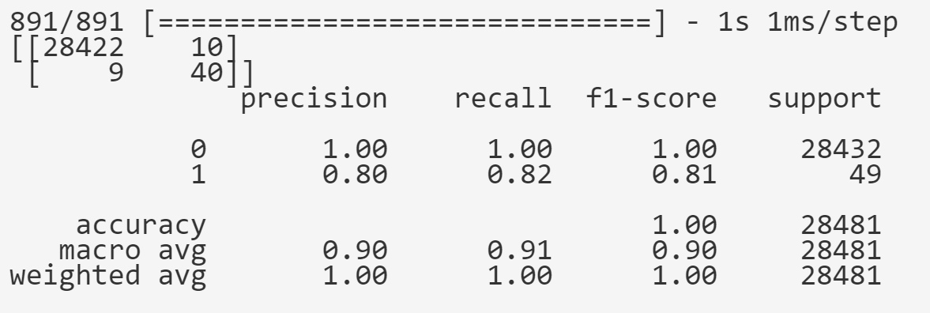
Artificial neural networks
Model 1

Slide 15
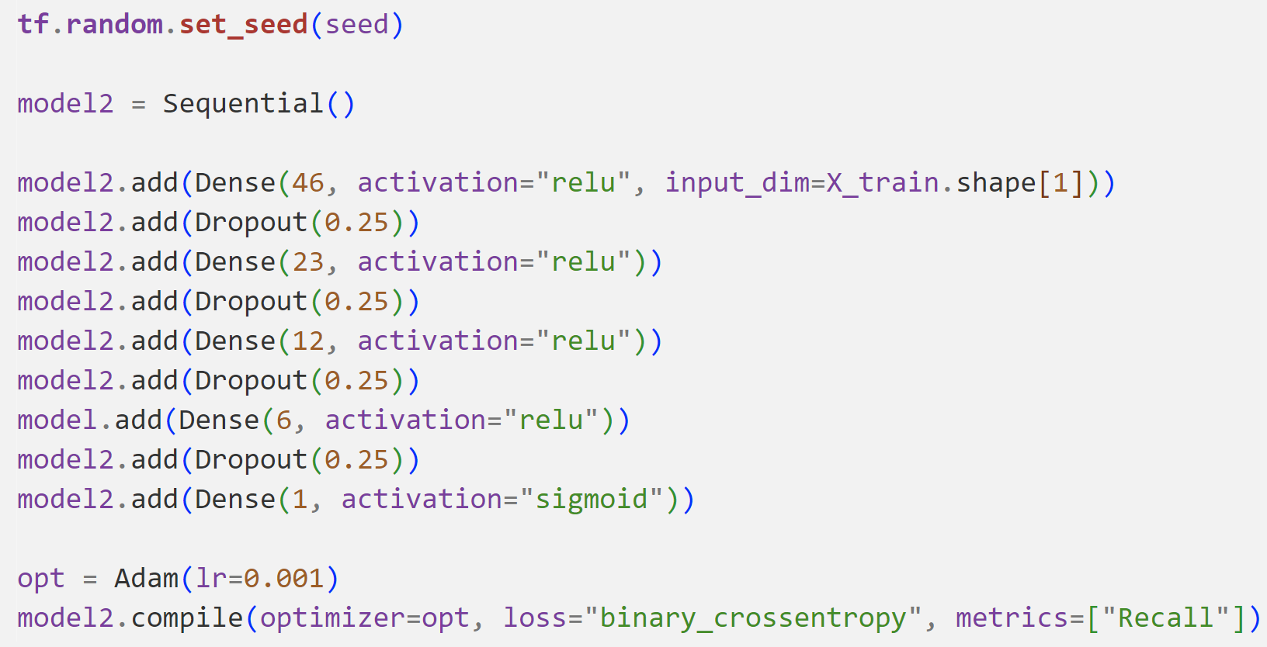
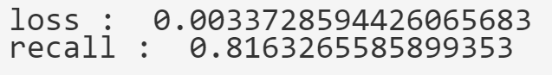
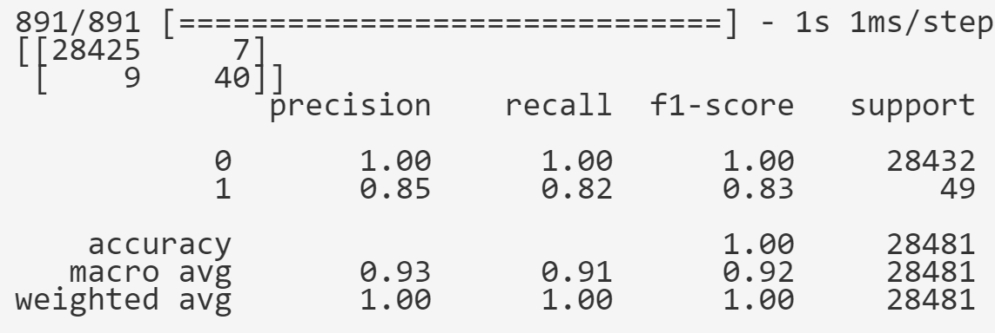
Artificial neural networks
Model 2

Slide 16
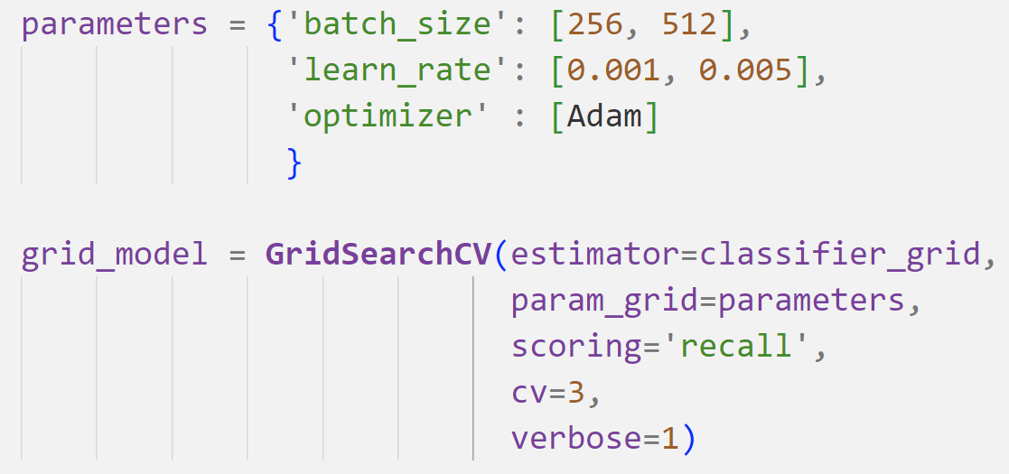
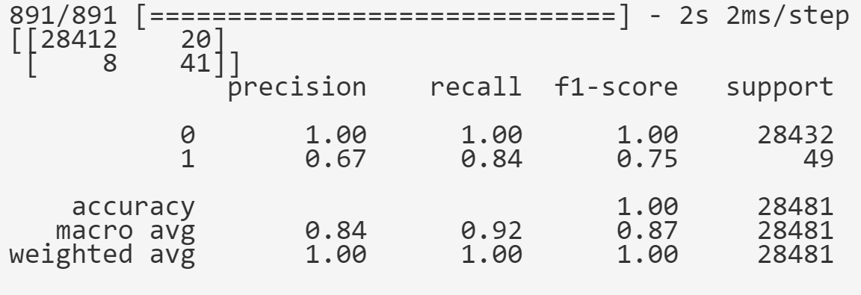
Artificial neural networks
Tuned Model

Slide 17
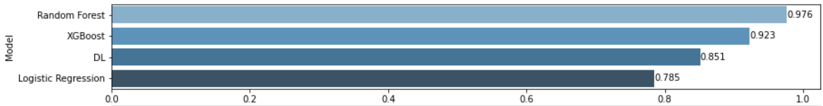
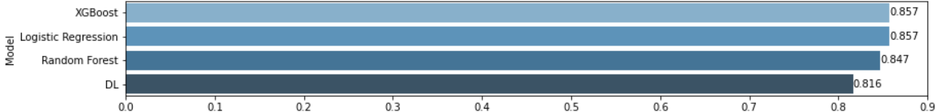
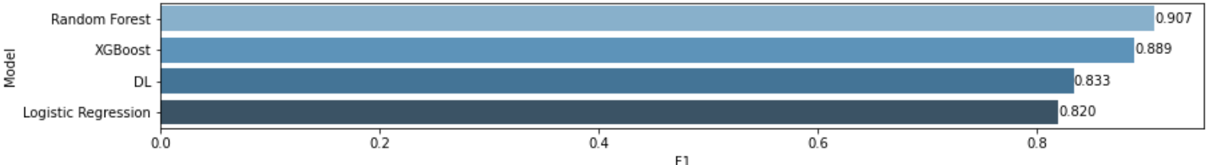
model comparison
Precision
Recall
F1

Slide 18
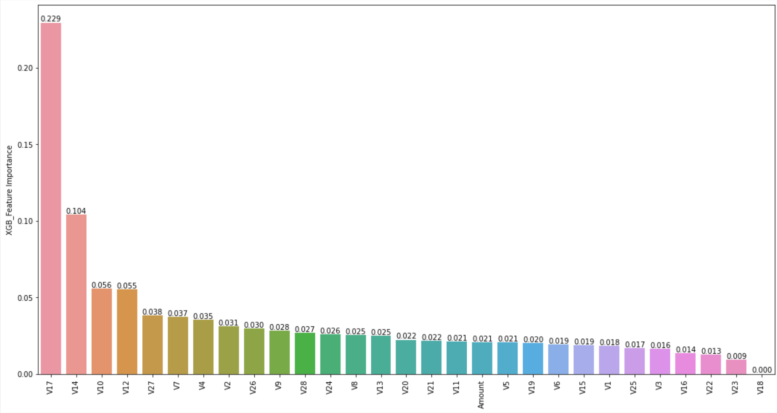
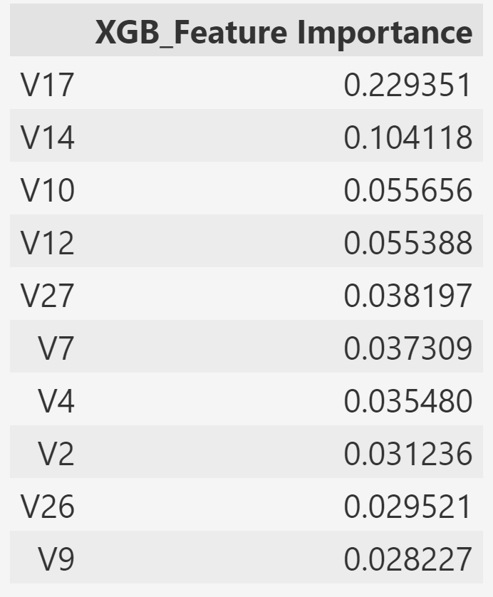
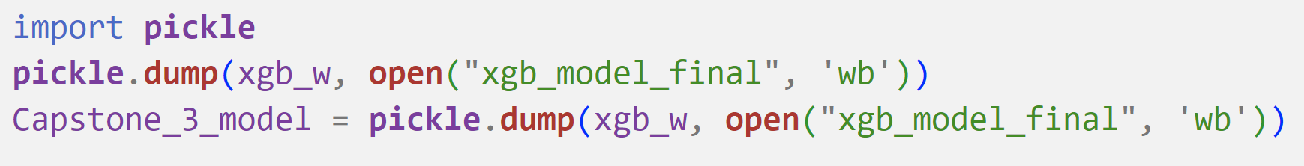
Feature importance & saving best model

Slide 19
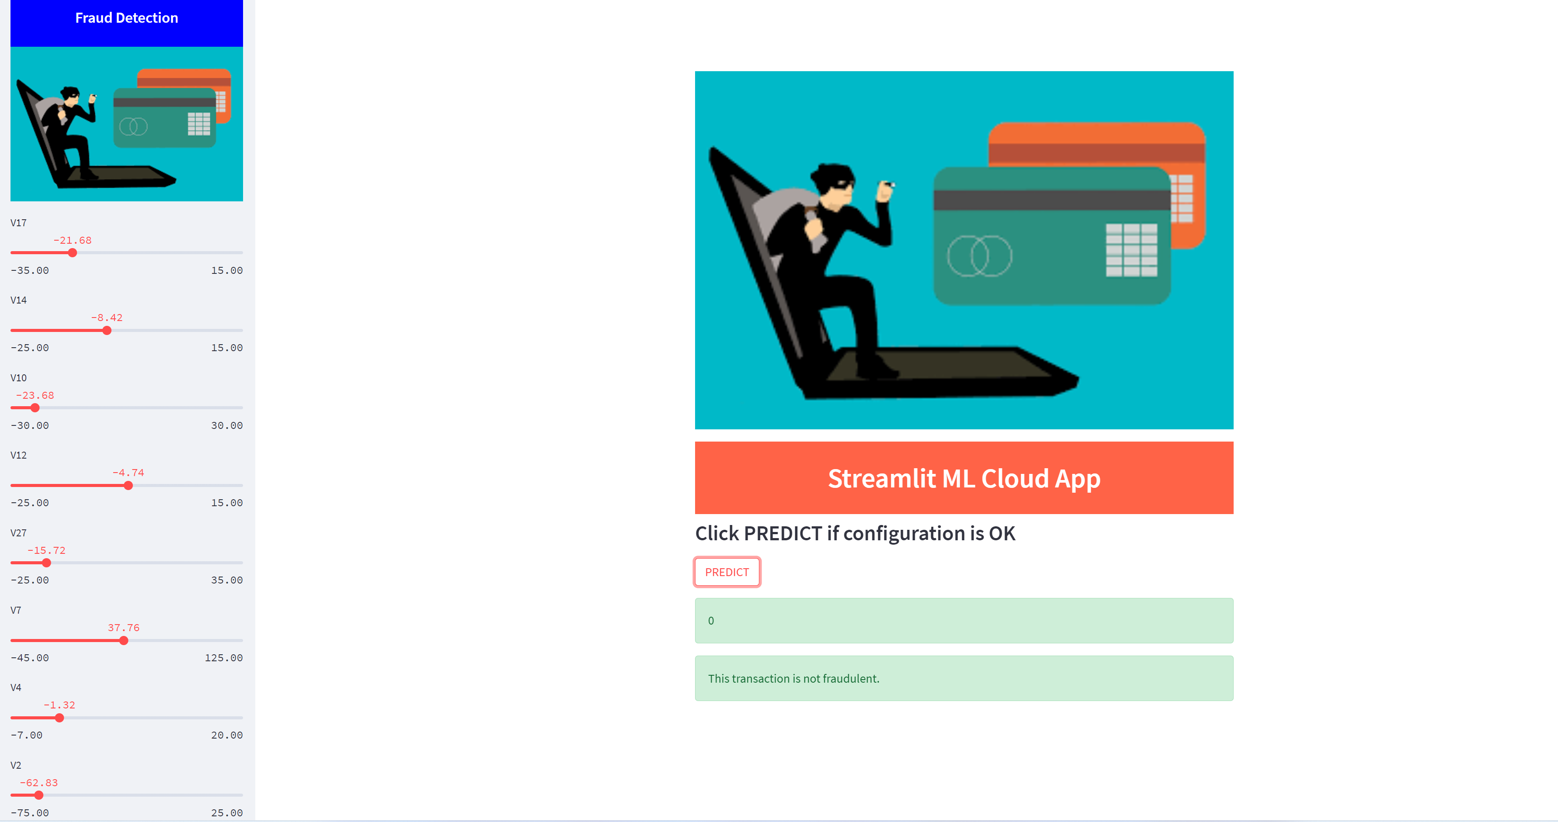
MODEL DEPLOYMENt with streamlit

